Slide 1

CI/CD: Continuous Integration & Continuous Delivery
A practical primer on automating code integration, testing, and deployment to deliver software faster and more reliably.

Slide 2


CORE CONCEPT
What is CI/CD?
CI/CD (Continuous Integration / Continuous Delivery or Deployment) is a set of practices that automates the entire software delivery process—from code integration through testing to deployment.
By automating these critical steps, teams can ship updates more frequently, catch bugs earlier, and reduce the manual effort required to get code into production. The result is faster, safer releases with fewer surprises.

Slide 3
UNDERSTANDING THE DIFFERENCES
CI vs CD: Breaking Down the Acronym
Continuous Integration (CI)
Continuous Delivery (CD)
Continuous Deployment
Code is always maintained in a deployable state and ready to go to production. Deployments are triggered manually, giving teams control over when releases happen whilst maintaining readiness.
Every code change that passes all automated tests is automatically deployed to production without manual intervention. This represents full automation of the entire release process.
Developers frequently merge code changes into a shared repository multiple times a day. Each integration triggers automated builds and tests, ensuring new code works alongside existing code and catching conflicts early.

Slide 4

Why CI/CD Matters
Faster Time to Market
Early Bug Detection
Automated pipelines eliminate bottlenecks and reduce the time between writing code and delivering value to customers. Ship features in days rather than weeks.
Automated testing catches issues immediately after code is committed, when they're cheapest and easiest to fix. Find problems before they reach production.
Reduced Human Error
Better Collaboration
Automation removes manual deployment steps that are prone to mistakes. Consistent, repeatable processes mean fewer surprises and rollbacks.
Teams work from the same codebase with clear visibility into changes. Developers, testers, and operations unite around shared pipelines and goals.

Slide 5

PIPELINE COMPONENTS
The Five Stages of a CI/CD Pipeline
Source Control
Deploy & Release
Build & Test
Every CI/CD pipeline follows this fundamental sequence. Code moves from source control through build and test stages, then deploys to various environments before final release to users. Each stage adds confidence that changes are ready for production.

Slide 6
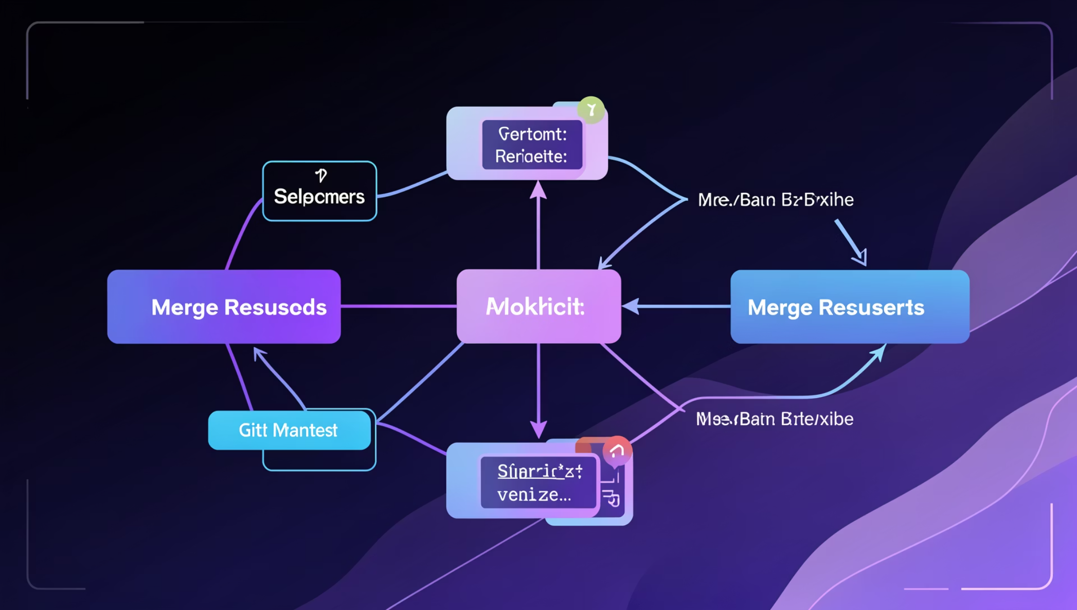
Stage 1: Source Control
Managing Code Versions and Collaboration
Source control is the foundation of CI/CD. It tracks every change to your codebase, enabling teams to work in parallel without conflicts.
Common actions:
Code commits to share changes
Branching for feature development
Pull requests for code review
Merging approved changes
Popular tools: GitHub, Azure Repos, GitLab

Slide 7
Stages 2 & 3: Build and Test
1
2
Build Stage
Test Stage
Converts source code into executable artifacts—the compiled, packaged application ready to deploy.
Automated testing validates code quality and correctness before deployment, catching regressions immediately.
Examples: Compiling Java code, generating .jar or .war files, bundling JavaScript with npm.
Test types: Unit tests (individual functions), integration tests (component interactions), smoke tests (basic functionality).
Tools: Maven, Gradle, npm, MSBuild
Tools: JUnit, Selenium, NUnit, Jest

Slide 8
Stages 4 & 5: Deploy and Release
Deploy: Releasing to Environments
Dev Environment
Deployment pushes your application through progressively production-like environments, each providing another layer of validation.
Initial deployment for development testing
Test Environment
Release: Final Rollout
Quality assurance validation
The release stage represents the final approval and rollout to users. It includes version tagging, monitoring setup, and crucially—a rollback strategy if issues arise.
UAT Environment
User acceptance testing with stakeholders
Production
Final release to end users

Slide 9
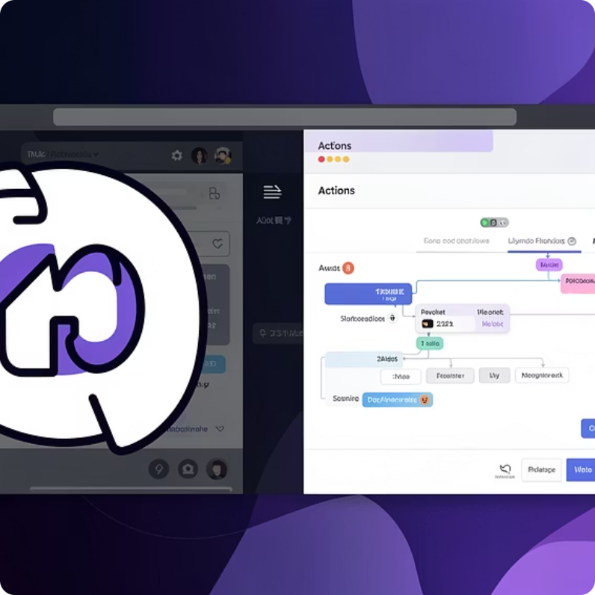
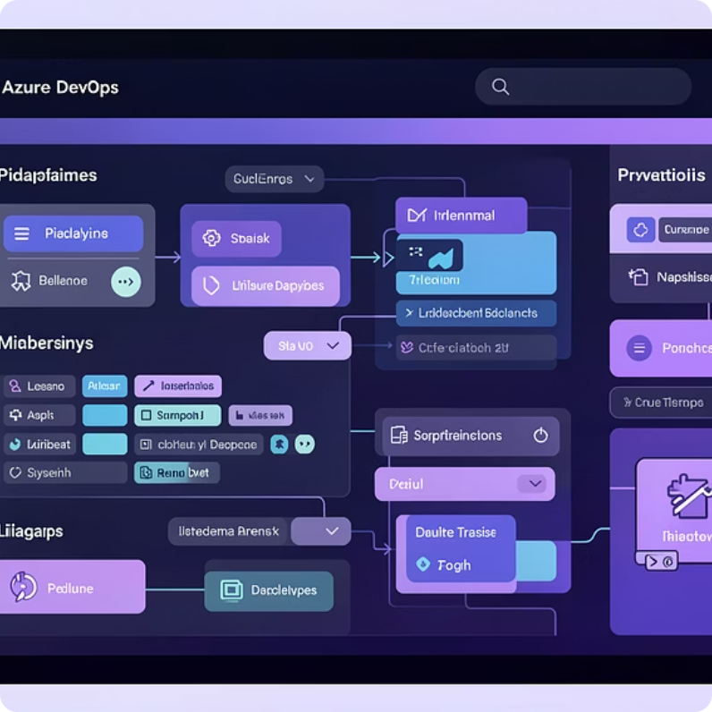
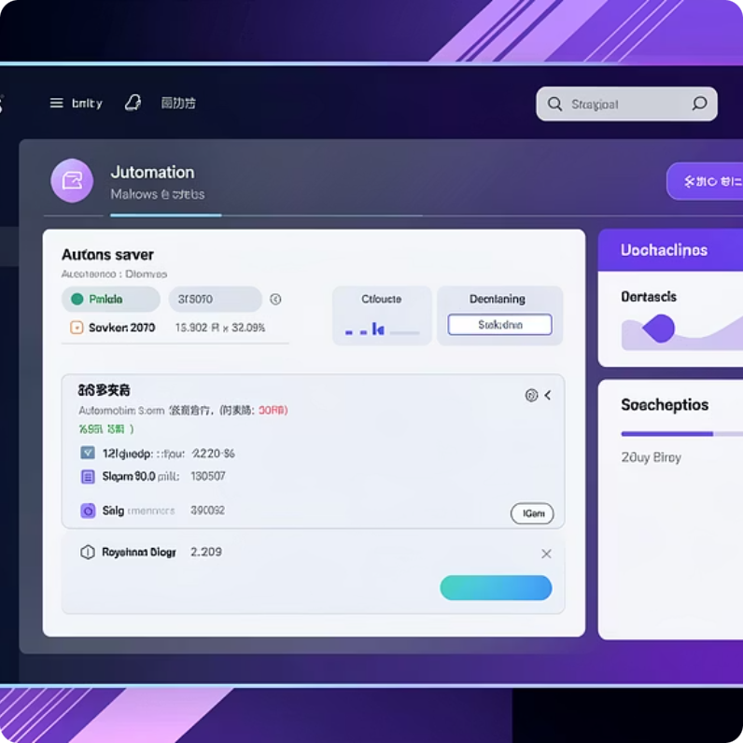
TOOLING ECOSYSTEM
Popular CI/CD Tools
GitHub
Azure DevOps
Jenkins
Source code repository with integrated CI/CD through GitHub Actions. Popular for open-source projects and simple workflows.
End-to-end platform with Azure Repos (source control), Azure Pipelines (CI/CD), and YAML-based pipeline definitions. Enterprise-ready with cloud and self-hosted agents.
Open-source automation server with plugin-based architecture. Highly customisable for complex build automation and deployment scenarios.

Slide 10
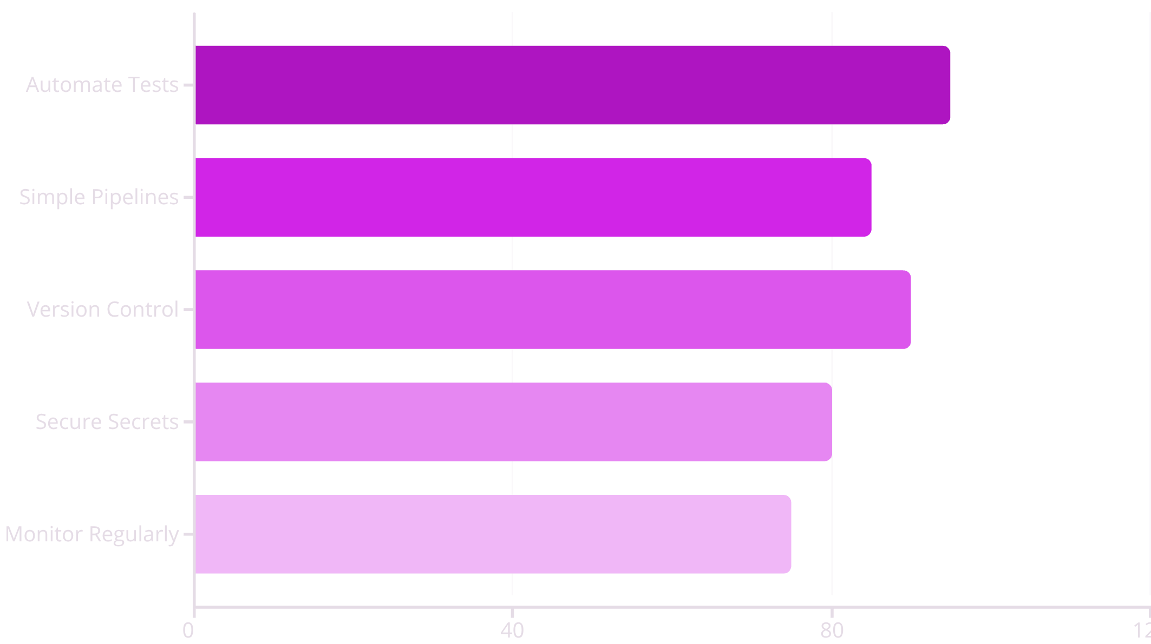
BEST PRACTICES
Keys to CI/CD Success
Success with CI/CD requires discipline and continuous improvement. These practices form the foundation:
Keep pipelines simple – complexity breeds fragility
Automate tests early – catch issues before they spread
Version control everything – including pipeline definitions
Secure secrets properly – never commit credentials
Monitor continuously – track pipeline health and metrics
Remember: CI/CD is a journey, not a destination. Start small, prove value, then expand automation gradually.

